Slide 1
IETF117 – ROSA side meeting
https://datatracker.ietf.org/doc/draft-contreras-rtgwg-rosa-gaar/
https://datatracker.ietf.org/doc/html/draft-trossen-rtgwg-rosa-arch
Requirements and Blueprint for an approach
Dirk Trossen (Huawei), Luis Contreras (Telefonica), J. Finkhaeuser (Interpeer), P. Mendes (Airbus)
24.07.2023

Slide 2
Key Requirements
Note: Draft points to specific use cases of relevance for each requirement
MUST provide means to associate service instances with a single service address
Additional MUST on secure association and SHOULD on obfuscation
-> ensures suitable service address->locator mappings
MUST provide means to announce route(s) to specific instances realizing a specific service address, thus enabling service equivalence for this set of service instances.
Limited to single ROSA domains (islands)
-> ensures ability for deployed instances to establish suitable mapping information
MUST provide means to interconnect ROSA islands to other ROSA islands and non-ROSA clients
Captures announcement across and outside ROSA domains
-> ensures visibility of ROSA-based services to other ROSA domains
-> ensures visibility to non-ROSA clients
-> ensures visibility of non-ROSA services to ROSA clients
Possibly to be changed to SHOULD instead of MUST (for isolated service deployments)?

Slide 3
Key Requirements - continued
Solution MUST provide constraint-based (service) routing capability
MUST associate with specific service instance
-> ensures utilization of routing approaches for anycast selection
-> ensures service specificity of anycast selection
MUST provide an instance selection at ROSA domain ingress nodes only -> ensures ability to make ingress-local decisions over ALL choices
MUST provide an in-band data transfer capability in the process of determining the suitable service instance for any following data transfer within the same service transaction. -> captures main idea of ROSA to move from explicit to in-band resolution to reduce/remove resolution latency
MUST adhere to the affinity towards the service instance chosen in the initial service request of the service transaction, thus directing subsequent service transaction requests to same instance -> ensures that subsequent packets of an app-level transaction are sent to same initial choice Additional optional requirements on client and service/transaction mobility, handshake support, and endpoint integration

Slide 4
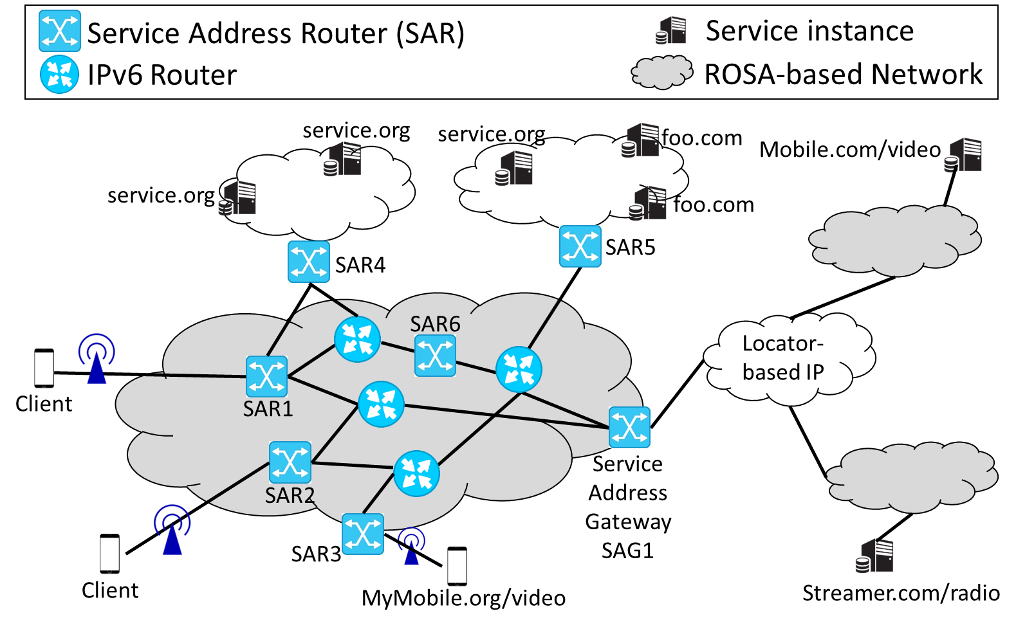
Blueprint Overview
SARs form a single ROSA domain overlay
Used to suitably forward service requests to one of possibly many service instances (REQ6)
Clients utilize underlying (IP) networks for affinity requests, thus bypassing ROSA overlay (REQ7) -> avoids network state for ensuring affinity
SAGs ensure interconnection (REQ3), if needed
To other ROSA domains
To non-ROSA services
-> no client-awareness needed
Clients access ROSA services (REQ6) through their dedicated ingress SAR, while service instances announce availability (REQ1+2) through theirs -> requires discovery methods

Slide 5
Main Message Flow
Client Ingress SAR Service Instance1 (IP=SI1) Service Instance 2 … Service Instance N
Service Request(Client IP, SAR IP)
In-band
Resolution
Determine next hop
Service Request(SAR IP, SI1 IP)
Generate response
Service Response(SI1 IP, SAR IP)
Affinity Request(clientIP, SI1 IP, port)
Service Response(SAR IP, Client IP)
.
.
.
Subsequent
Data Transfer
Service Request(Client IP, SAR IP)
New transaction
Key principle remains unchanged from DNS: discovery of an IP address, followed by subsequent data transfer
BUT: Resolution (service) request is sent via ROSA overlay, while future (affinity) packets follow the direct client->service instance IPv6 path
-> In-band transfer of higher layer data (within discovery IP packet) reduces transaction completion latency
-> New socket interface maintains mapping of service address to instance IP address for subsequent requests, i.e., code looks like any socket-based app, changing the address type to AF_ROSA (instead of AF_INET)!
-> aligns with E2E argument in refraining from client/flow state being required outside endpoints to handle affinity

Slide 6
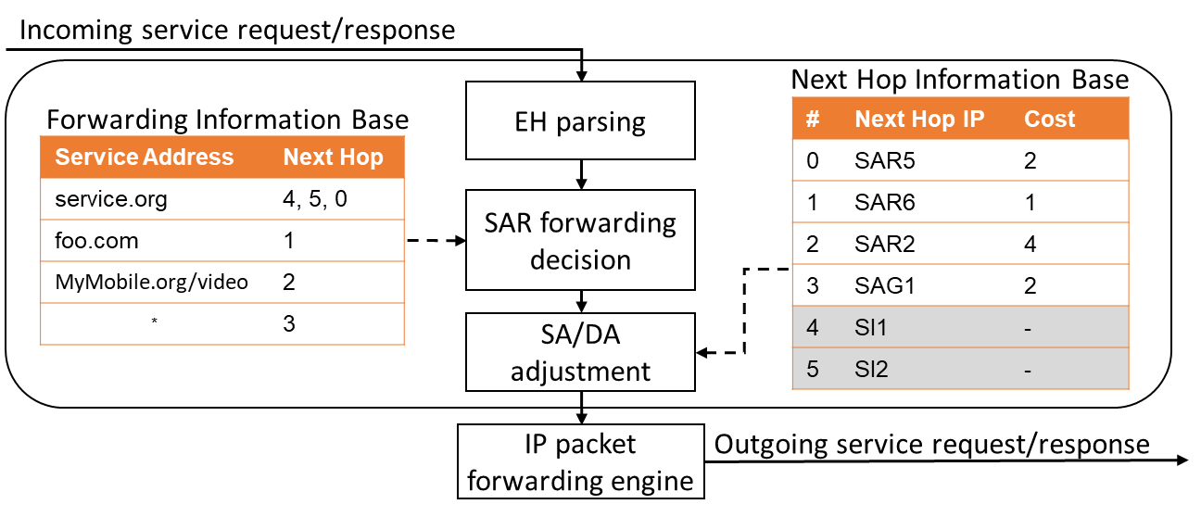
SAR Forwarding Engine
FIBs are populated by overlay routing protocol
Can re-use existing routing protocols
NOTE: the number of FIB entries is limited by those services announced to the local ROSA domain only! -> allows for constraining routing tables through the domain-local business relations
Traffic steering based on
Routing (REQ4), i.e., sending service request to the ‘best’ service instance according to routing metric
Request scheduling (REQ5), i.e., sending service request to one of possibly many instance at runtime
-> supports any traffic steering mechanism -> Not necessarily compute-aware, e.g., may apply multi- optimality routing methods
Wildcard service address points to SAG for domain-remote services
Could be deployed at CDN to serve PoP-based request first, before directing to Internet
Prototype transaction speed of 245k packets-per-second
achieved in a Laptop-based 4 core i7 setup

Slide 7
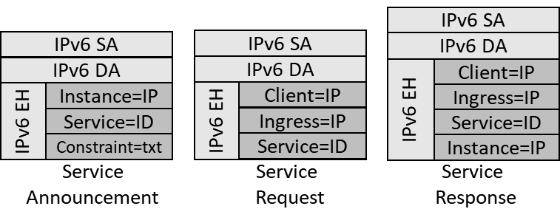
Possible Encoding of Resolution Information in the Overlay
Using IPv6 Destination* Extension Headers for ‘Lowest Possibly Overlay’
* The use of destination EH makes ROSA an overlay, i.e., it realizes the SARs as IPv6 endpoints!

Slide 8
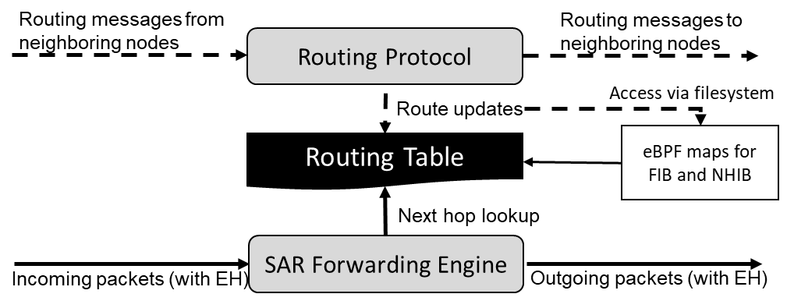
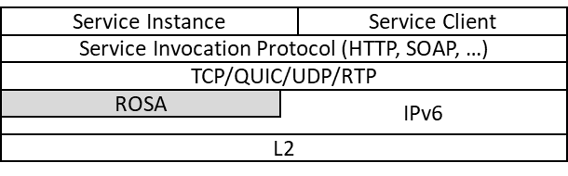
Prototype
SAR as Linux-based SW node
Forwarding as eBPF module
Routing tables as eBPF maps
Routing module in user space, manipulating pinned maps based on service announcements
Client/server as user space socket library
Can be linked to code through own SDK
Suite of test and demo code realized
Forwarding performance
Discovery latency
Conceptual demo
Use cases to come
As Shim, sitting between transport and IPv6

Slide 9
QUESTIONS TO CLARIFY BEFORE PRESENTING
Shall we add deployment discussions (3 slides)?
Any other arch information to be added?

Slide 10
IETF117 – ROSA side meeting
https://datatracker.ietf.org/doc/draft-contreras-rtgwg-rosa-gaar/
https://datatracker.ietf.org/doc/html/draft-trossen-rtgwg-rosa-arch
Questions, Opinions, Criticism?
THANKS!
24.07.2023

